Slide 1

National Infrastructure Database-Modernized
By:
Jordan Stella
Duru Elli
Mohammed Aishat

Slide 2

Our project Goals
Build a relational database
Provide clean project tracking
Make XML & JSON data accessible
Create a prototype website
Demonstrate how ICC can use this system

Slide 3
The Problem
Canada struggles with tracking large-scale infrastructure projects
Government departments rely on disconnected spreadsheets
Information is scattered between provinces and contractors
Difficult to monitor project progress in real time
Leads to delays, budgeting issues, and poor transparency

Slide 4
Why Centralization Matters
Single Source of Truth
Better Transparency
Faster Decision-Making
Reduced Errors
Efficient Oversight

Slide 5
Database Structure Breakdown
Projects: Stores project details (ID, Name, Status, Budget, HQ, Winning Bidder)
Provinces: Stores region info
Contractors: Stores contractor details
Project Assignments/Tenders: Links contractors to projects
Ensures clean, consistent data and avoids duplication

Slide 6

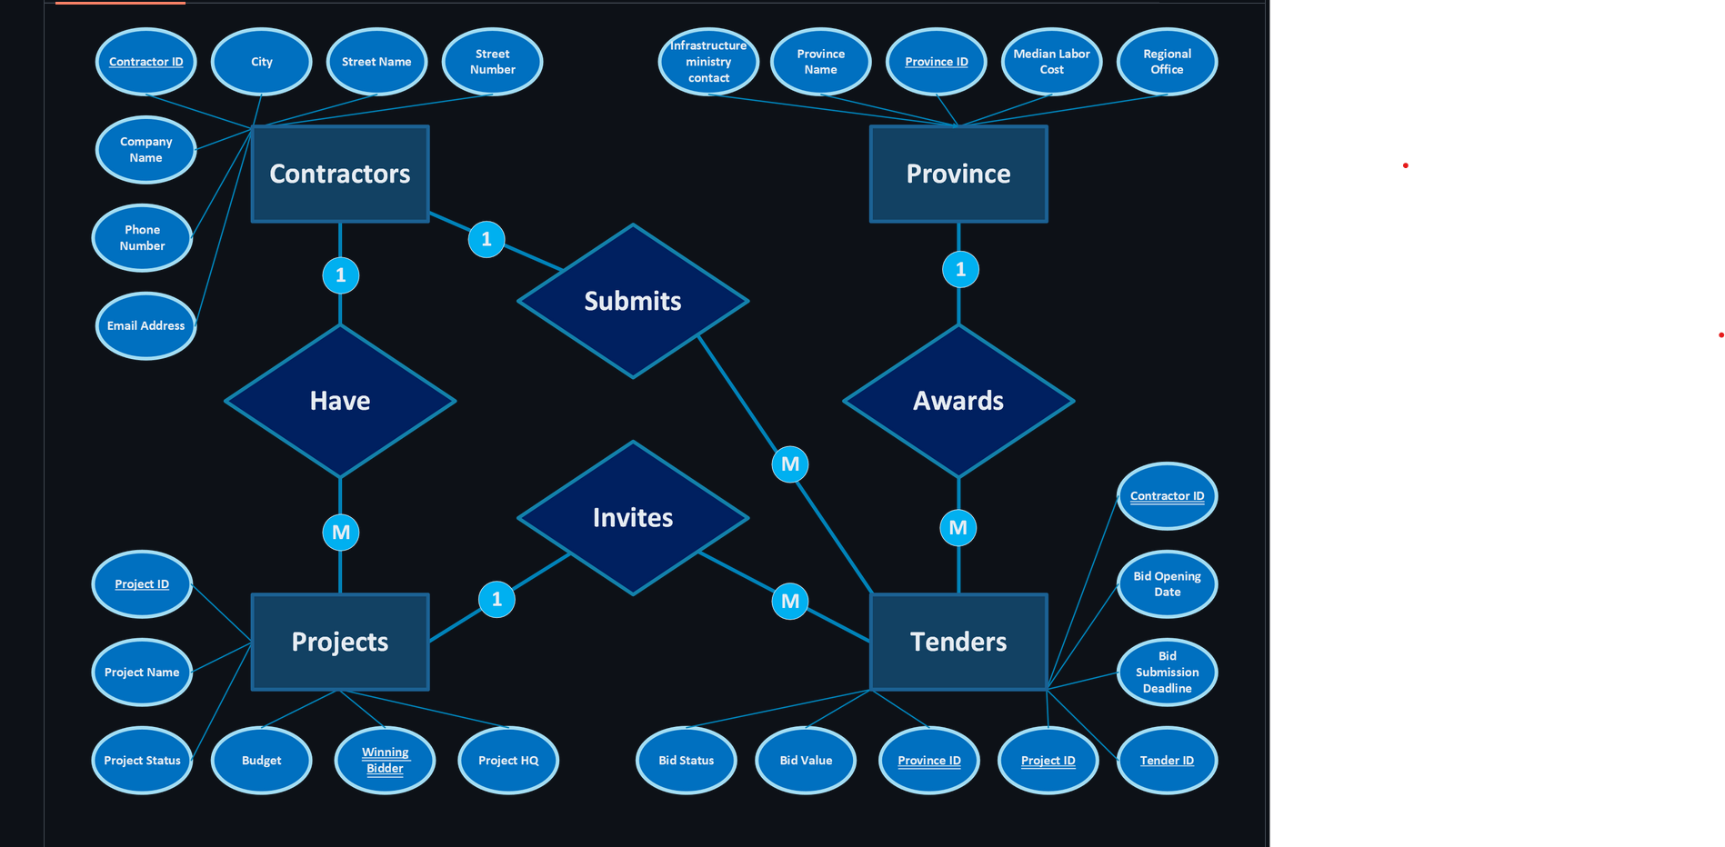
ERD Overview
The ERD maps out how all project information connects
Includes major tables: Projects, Contractors, Provinces

Slide 7
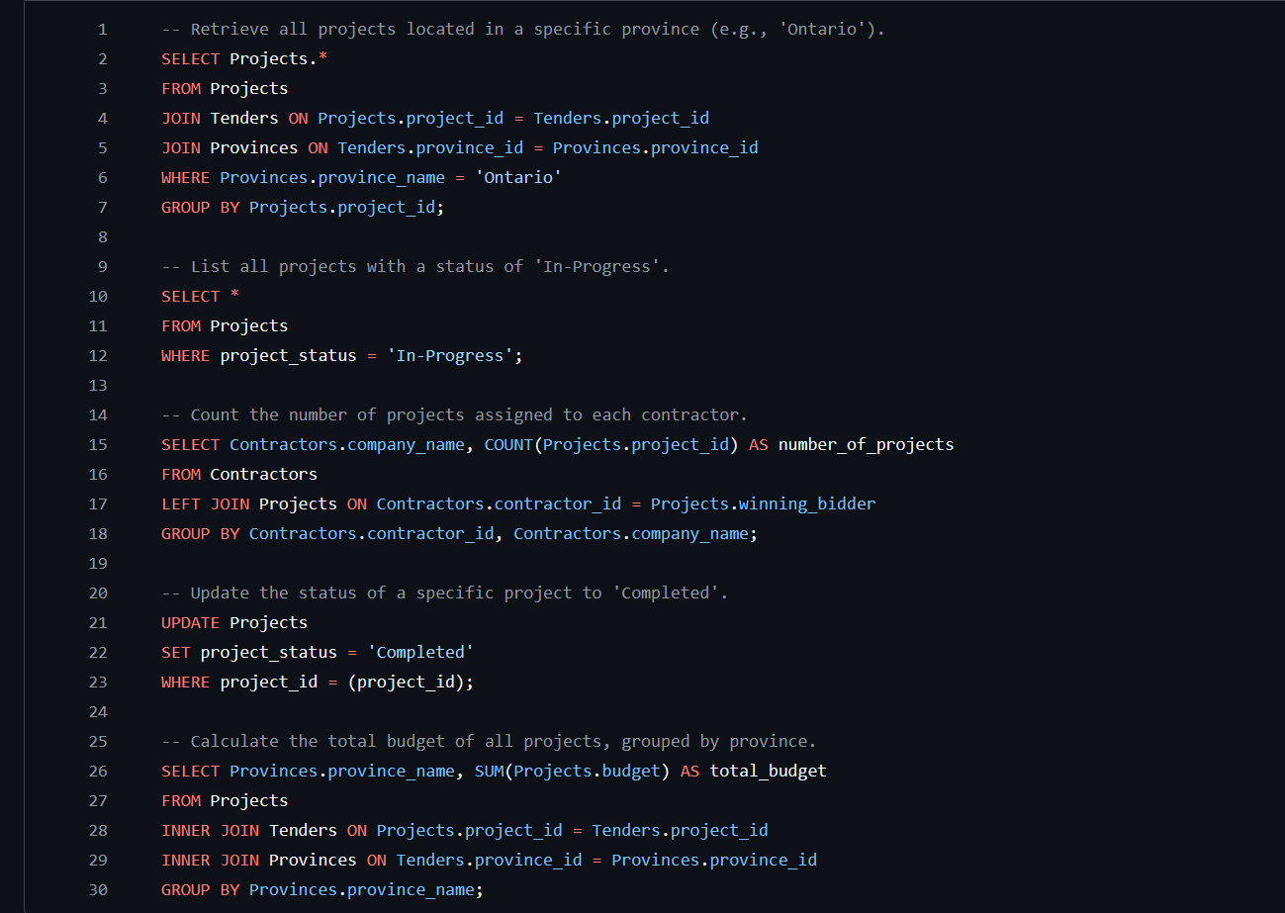
SQL Demo: Key Queries
Projects by province
In-Progress projects
Projects per contractor
Update status
Budget by province

Slide 8

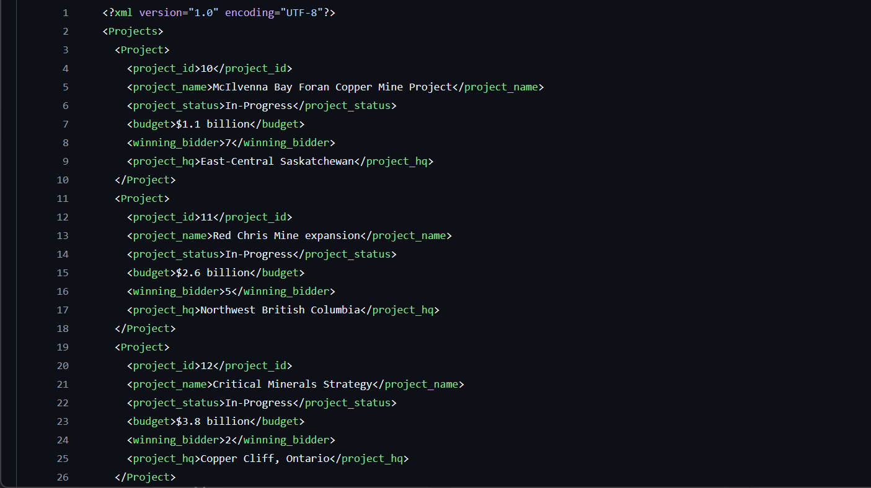
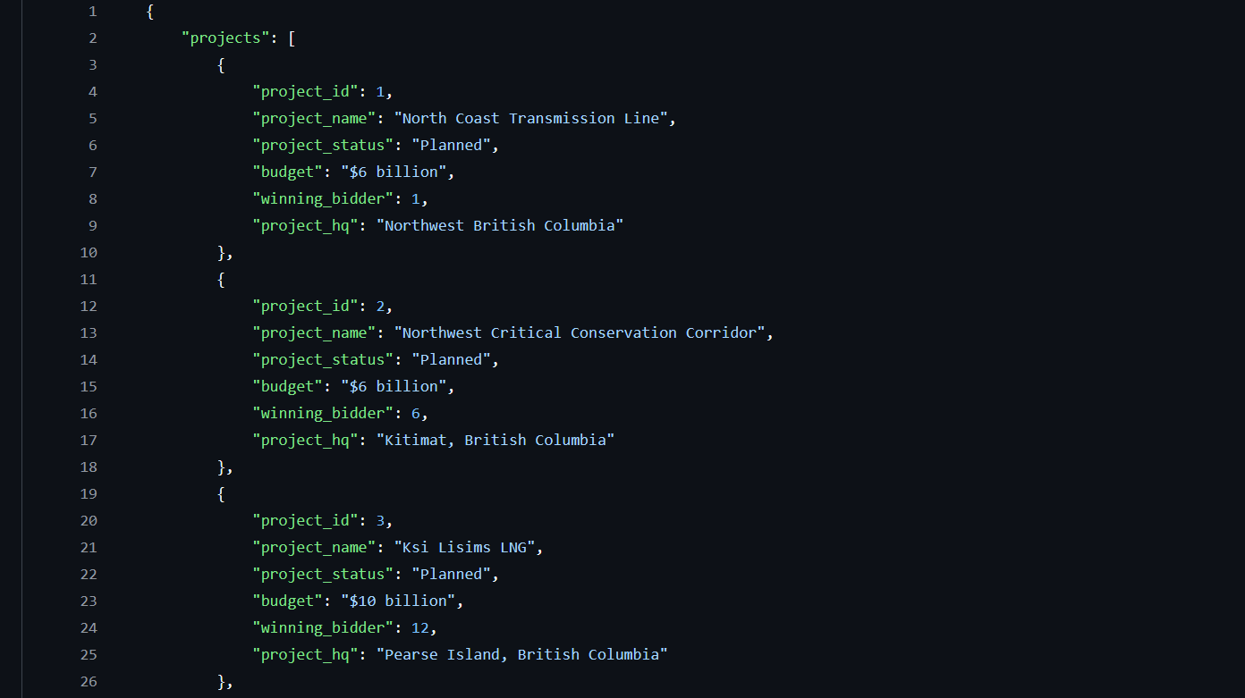
Project Data – XML & JSON
in-Progress Projects (XML)
Tracks active infrastructure projects across Canada
Structured using proper XML tags for clarity and consistency
Stores essential details: Project ID, Name, Status, Budget, Winning Bidder, Headquarters
Planned Projects (JSON)
Contains upcoming projects in the planning stage
Organized as a clean JSON array for easy integration with web or database systems
Each project includes: Project ID, Name, Status, Budget, Winning Bidder, Headquarters
Slide Visual Idea

Slide 9
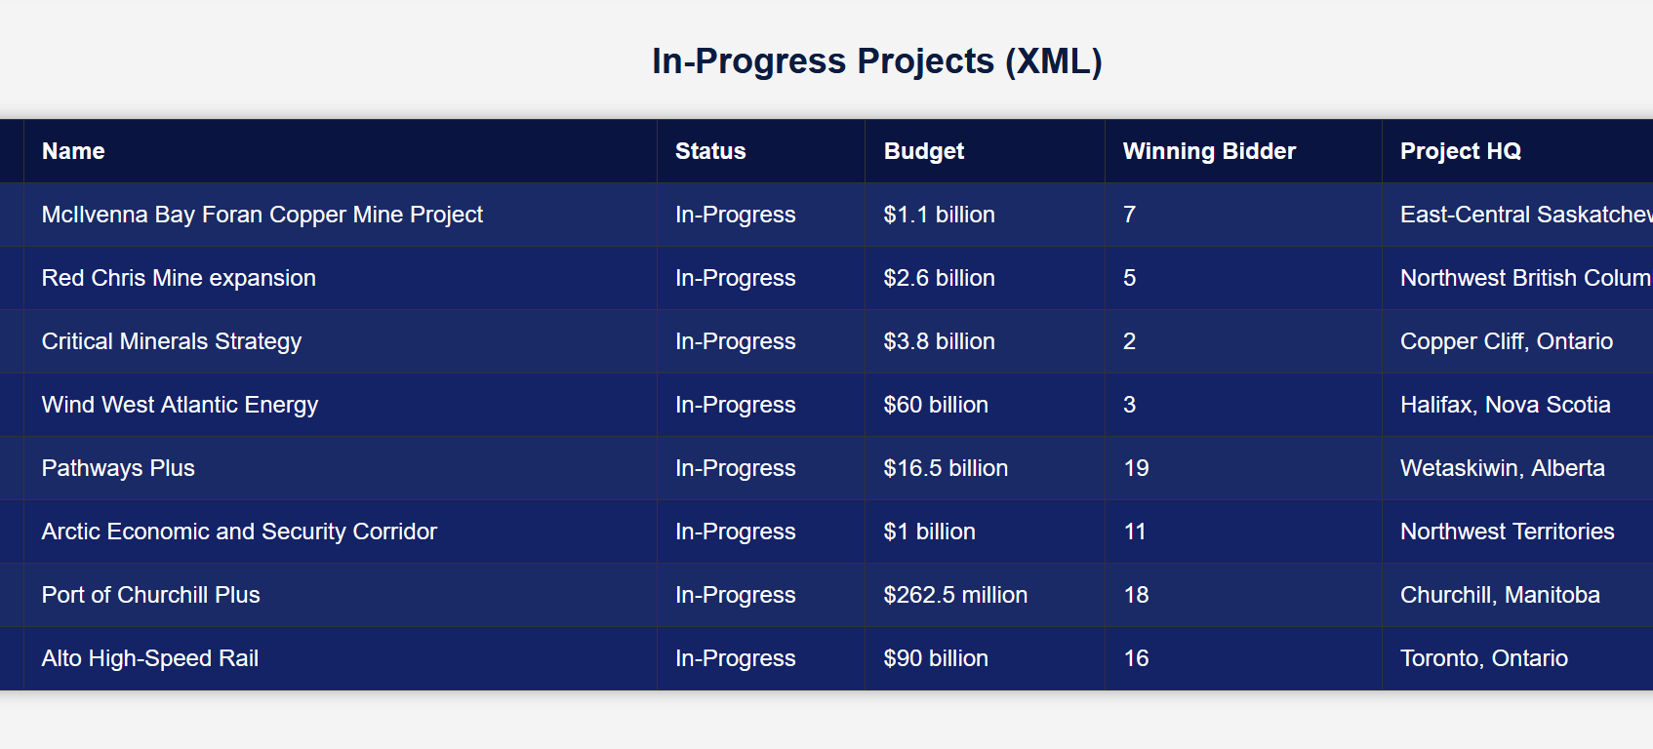
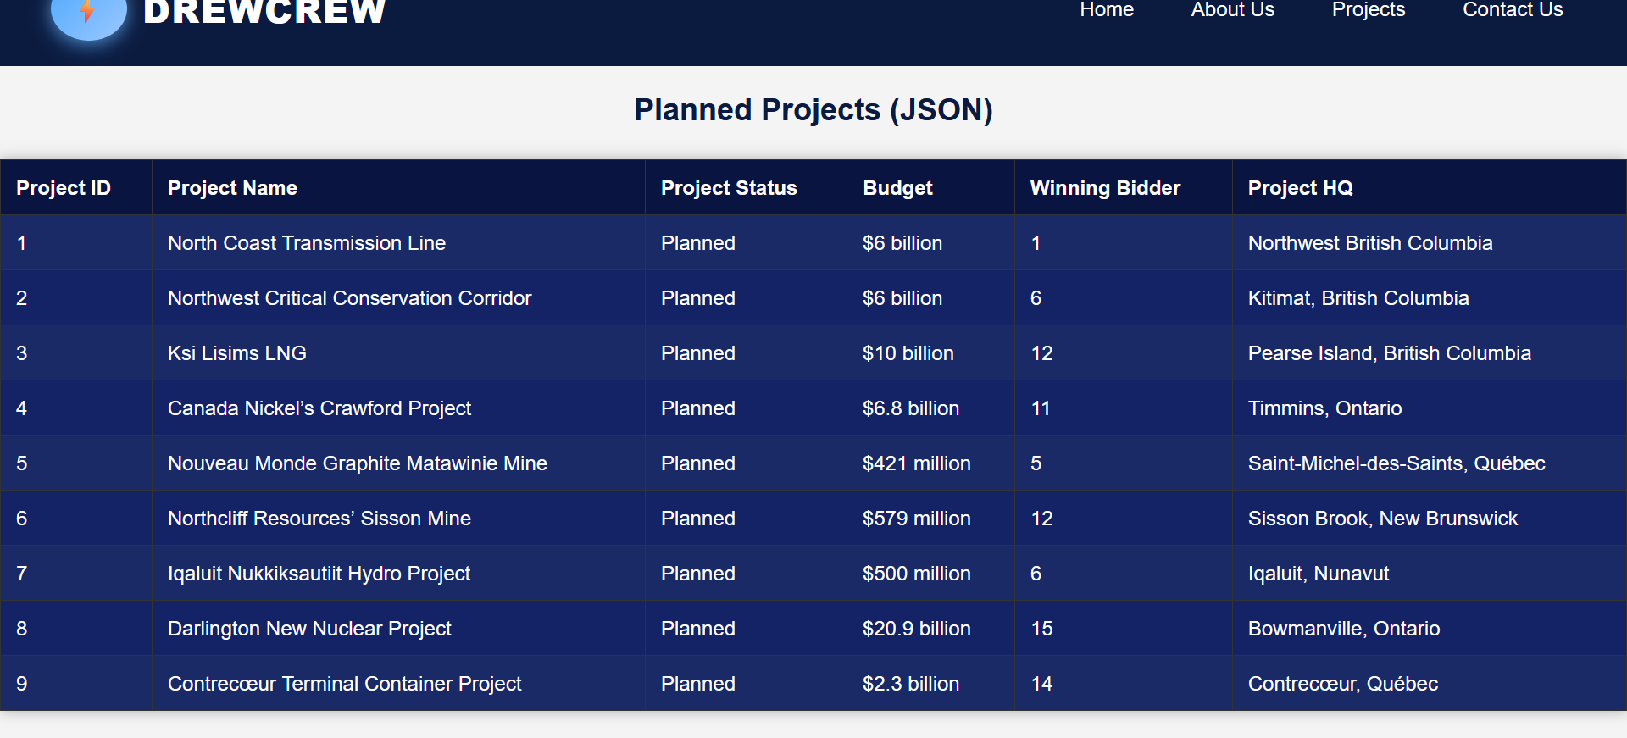
Proof of Concept Webpage
Home Page
About Us Page
Projects Page
Dynamically displays project data
Data fetched live from GitHub for demonstration
Contact Us Page

Slide 10

Our Proposed Solution
Improve the tracking and management of national infrastructure projects in Canada
Replace disconnected spreadsheets with a centralized, reliable system
Supports decision-making, budgeting, and project oversight
Accessible Data

Slide 11
Project Final Impact
Makes project progress, budgets, and contractors visible at a glance
Helps ICC spot delays, risks, and cost issues quickly
Demonstrates real-world use of XML, JSON, and database integration
Brings all project information together in a single, reliable system
Provides an interactive website to view and manage projects efficiently

Slide 12
  QUESTIONS

